Slide 1


THE MAIN GOAL
PERSONAL EXPENSE TRACKER
Managing personal finances can often lead to overspending and a lack of financial clarity. Our project addresses this challenge head-on
PROBLEM STATEMENT
Individuals struggle with manual expense tracking, leading to poor financial insights and budgeting difficulties.
A Streamlit-powered application for insightful financial management and expense tracking.
Project By:
Aarush Dambal (PRN: 1262253440)
Syed Rushan (PRN: 1262254036)
Krishna Rajeev (PRN: 1262250802)
Rushil Mital (PRN: 1262253595)
Anushri Gawande (PRN: 1262253726)
Chinmay Sail (PRN: 1262251017)
Under the Guidance of:
Dr. Neha Sathe
OBJECTIVE
To develop a user-friendly expense tracker that automates finance analysis, providing insights into spending habits and promoting better financial health.

Slide 2


THE MAIN GOAL
PERSONAL EXPENSE TRACKER
A Streamlit-powered application for insightful financial management and expense tracking.
METHODOLOGY
Managing personal finances can often lead to overspending and a lack of financial clarity. Our project addresses this challenge head-on
Our expense tracker leverages powerful Python libraries and a streamlined workflow for efficient data processing and visualisation
Users upload a CSV bank statement, which is then processed, analysed, and visualised to present a clear overview of their financial activities.
PROBLEM STATEMENT
Individuals struggle with manual expense tracking, leading to poor financial insights and budgeting difficulties.
OBJECTIVE
To develop a user-friendly expense tracker that automates finance analysis, providing insights into spending habits and promoting better financial health.
Project By:
Aarush Dambal (PRN: 1262253440)
Syed Rushan (PRN: 1262254036)
Krishna Rajeev (PRN: 1262250802)
Rushil Mital (PRN: 126225)
Anushri Gawande (PRN: 126225)
Chinmay Sail (PRN: 126225)
Under the Guidance of:
Dr. Neha Sathe
KEY TOOLS AND LIBRARIES
Streamlit: For creating interactive web applications.
Pandas: For robust data manipulation and analysis.
Matplotlib: For generating visualisations and charts.

Slide 3
METHODOLOGY
PROBLEM STATEMENT
Individuals struggle with manual expense tracking, leading to poor financial insights and budgeting difficulties.
THE MAIN GOAL
Managing personal finances can often lead to overspending and a lack of financial clarity. Our project addresses this challenge head-on
Our expense tracker leverages powerful Python libraries and a streamlined workflow for efficient data processing and visualization
Users upload a CSV bank statement, which is then processed, analyzed and visualized to present a clear overview of their financial activities.
KEY TOOLS AND LIBRARIES
Streamlit: For creating interactive web applications.
Pandas: For robust data manipulation and analysis.
Matplotlib: For generating visualisations and charts.
OBJECTIVE
To develop a user-friendly expense tracker that automates finance analysis, providing insights into spending habits and promoting better financial health.

Slide 4
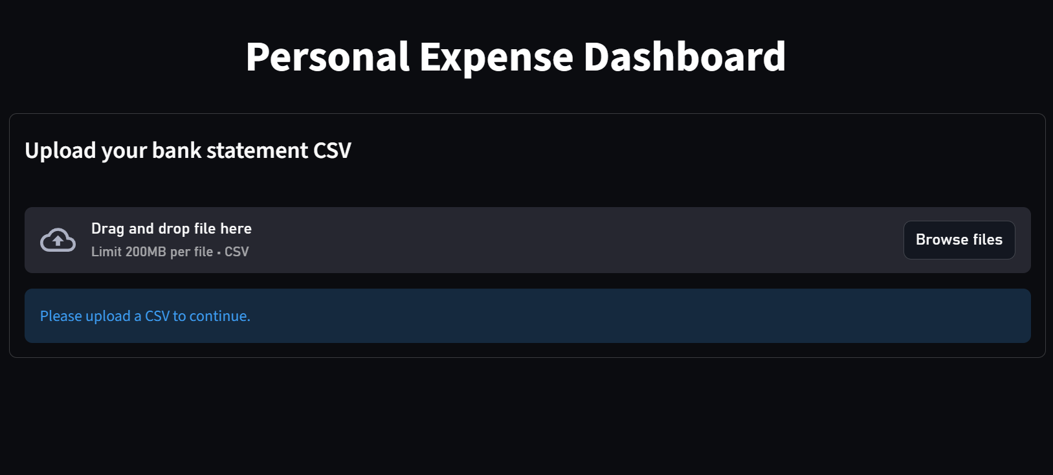
WORKFLOW
User uploads a bank statement CSV.
Immediately after upload, the dashboard becomes active.
If no file is uploaded, Streamlit shows a simple “Please upload a CSV” message.

Slide 5
User uploads a bank statement CSV.
Immediately after upload, the dashboard becomes active.
If no file is uploaded, Streamlit shows a simple “Please upload a CSV” message.
DATA LOADING AND PREPROCESSING
COLUMN NORMALIZATION
All column names are cleaned (trimmed + title-case).
Different bank formats are handled by renaming known variations such as:
  “Transaction Date” → “Date”
  “Expense” / “Value” → “Amount”
  “Expenses/Income”, “Income/Expense” → “Type”

Slide 6
User uploads a bank statement CSV.
Immediately after upload, the dashboard becomes active.
If no file is uploaded, Streamlit shows a simple “Please upload a CSV” message.
DATA LOADING AND PREPROCESSING
COLUMN NORMALIZATION
All column names are cleaned (trimmed + title-case).
Different bank formats are handled by renaming known variations such as:
  “Transaction Date” → “Date”
  “Expense” / “Value” → “Amount”
  “Expenses/Income”, “Income/Expense” → “Type”
ADDITIONAL FEATURES
In type column, rows labeled ‘Income’ are converted to negative amounts.
Month name and Month number column added for easier data visualization
DATATYPE CONVERSION
Converts Date to datetime format.
Converts Amount column to numeric.
Removes rows with missing dates or amounts.

Slide 7
DATA LOADING AND PREPROCESSING
COLUMN NORMALIZATION
All column names are cleaned (trimmed + title-case).
Different bank formats are handled by renaming known variations such as:
  “Transaction Date” → “Date”
  “Expense” / “Value” → “Amount”
  “Expenses/Income”, “Income/Expense” → “Type”
DATATYPE CONVERSION
Converts Date to datetime format.
Converts Amount column to numeric.
Removes rows with missing dates or amounts.
ADDITIONAL FEATURES
In type column, rows labeled ‘Income’ are converted to negative amounts.
Month name and Month number column added for easier data visualization

Slide 8
DATA LOADING AND PREPROCESSING
COLUMN NORMALIZATION
All column names are cleaned (trimmed + title-case).
Different bank formats are handled by renaming known variations such as:
  “Transaction Date” → “Date”
  “Expense” / “Value” → “Amount”
  “Expenses/Income”, “Income/Expense” → “Type”
DATATYPE CONVERSION
Converts Date to datetime format.
Converts Amount column to numeric.
Removes rows with missing dates or amounts.
ADDITIONAL FEATURES
In type column, rows labeled ‘Income’ are converted to negative amounts.
Month name and Month number column added for easier data visualization

Slide 9
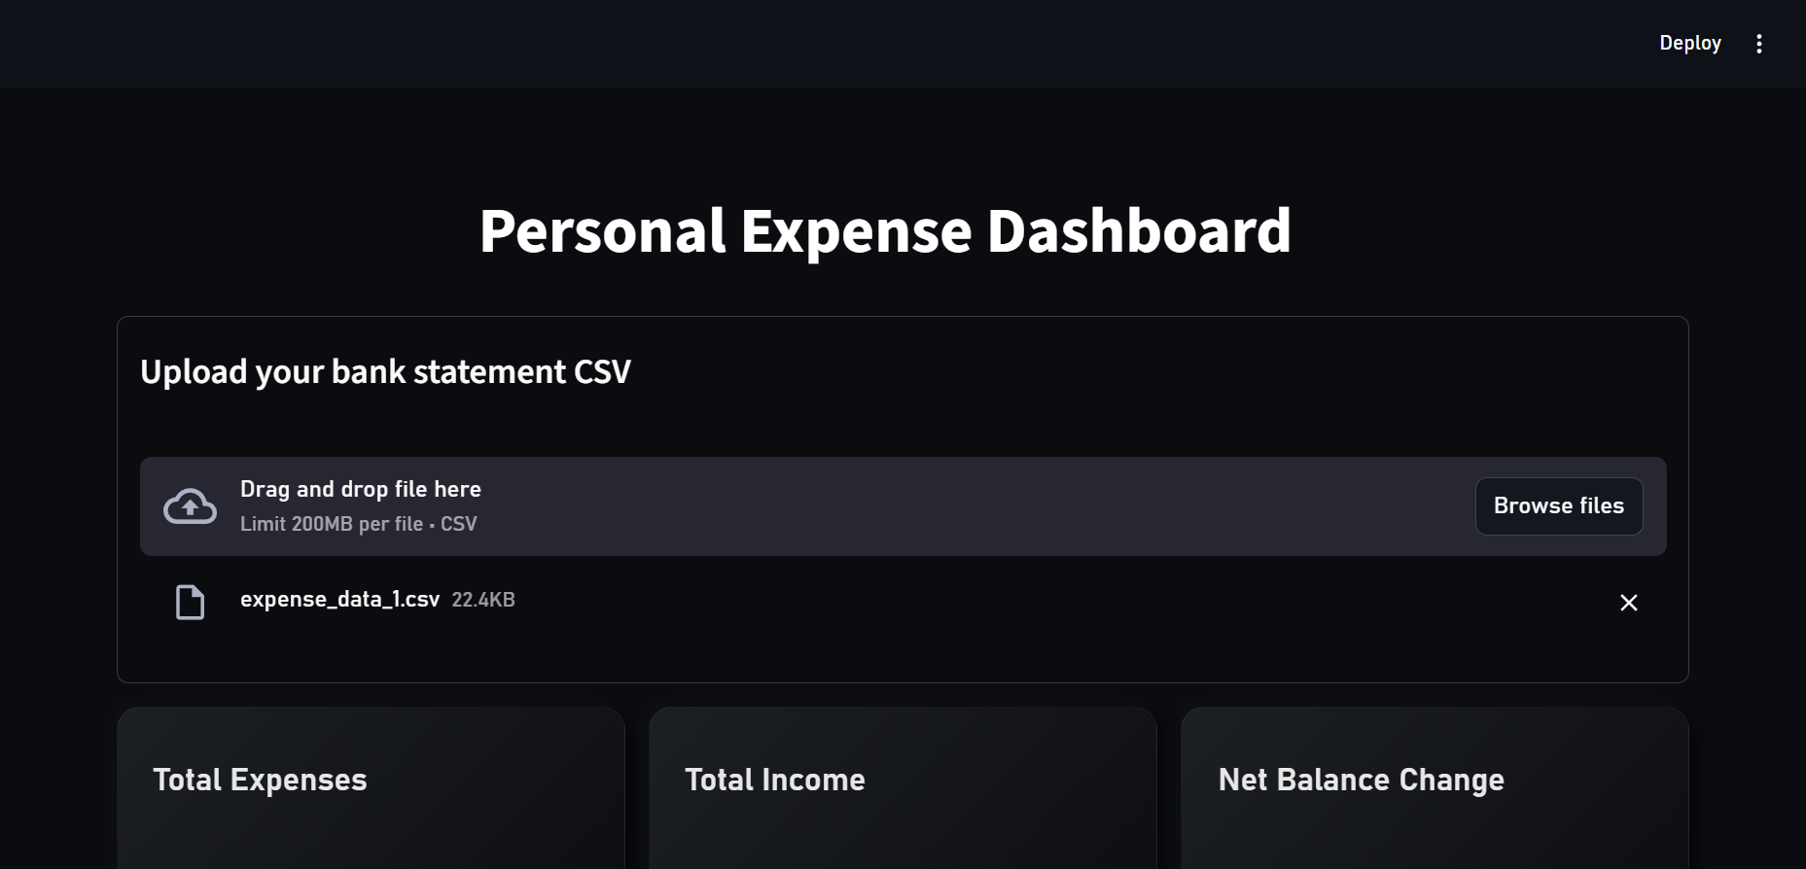
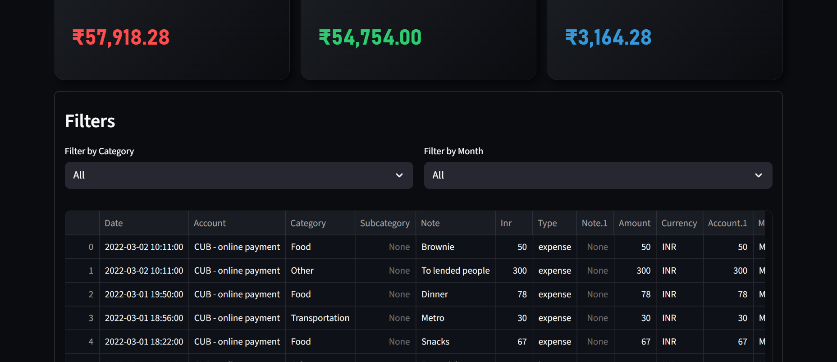
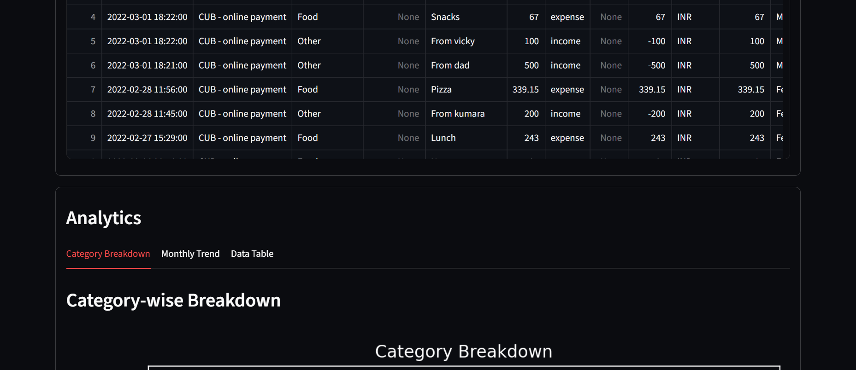
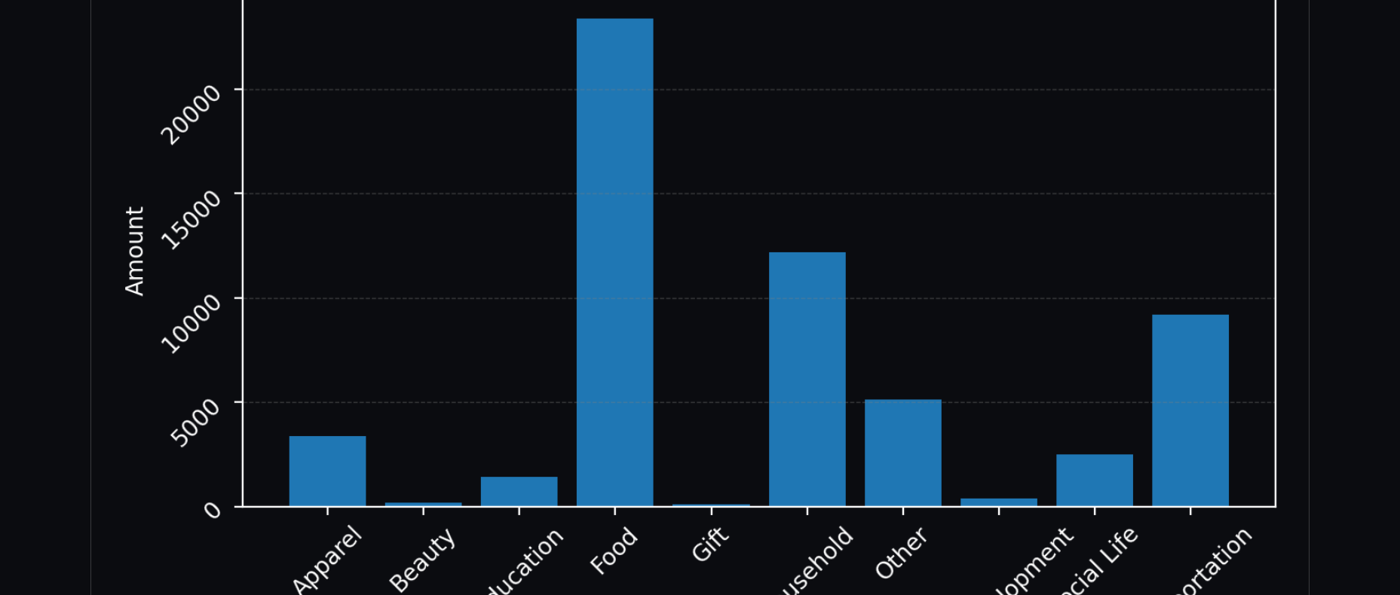
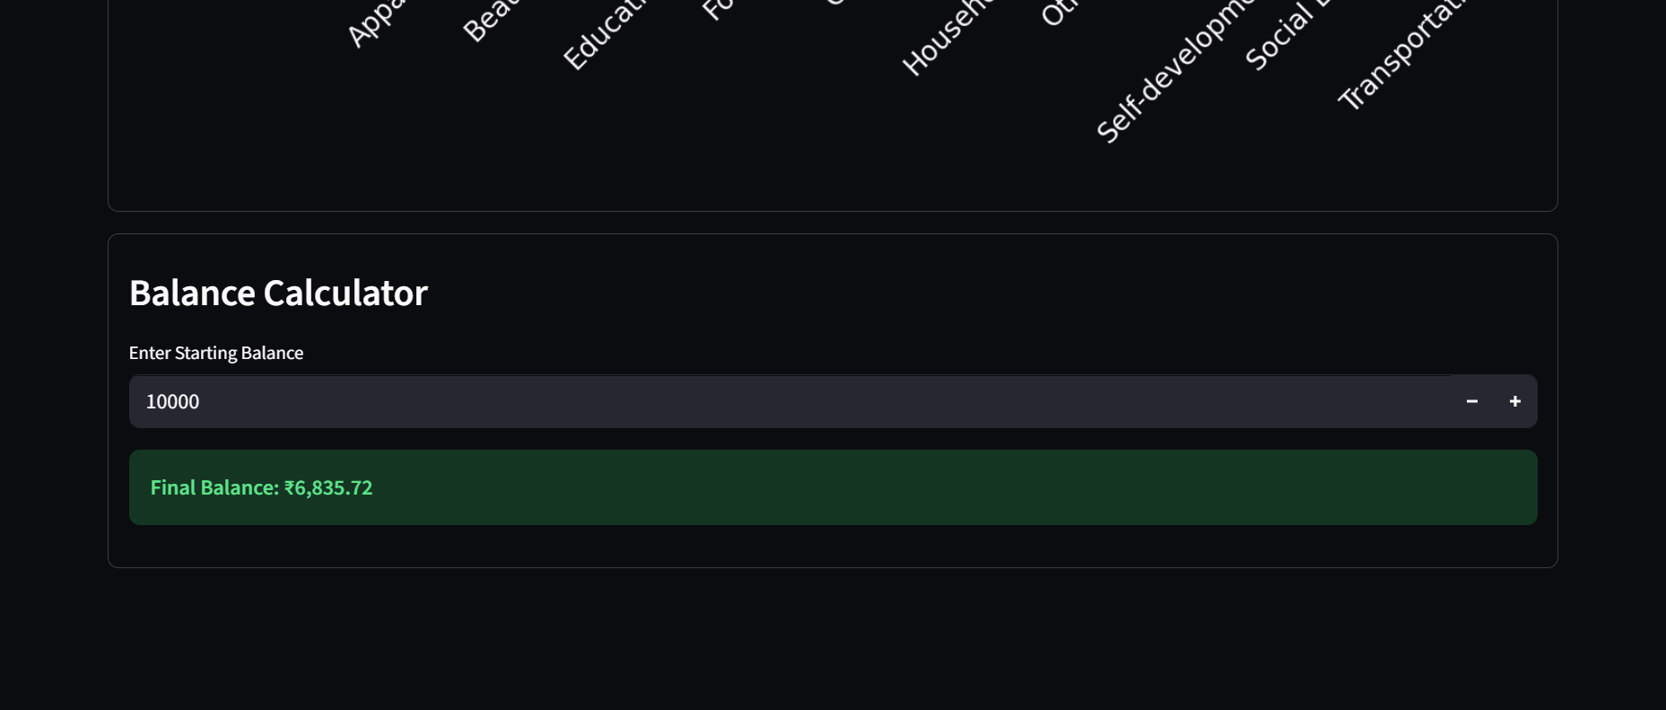
COLUMN NORMALIZATION
All column names are cleaned (trimmed + title-case).
Different bank formats are handled by renaming known variations such as:
  “Transaction Date” → “Date”
  “Expense” / “Value” → “Amount”
  “Expenses/Income”, “Income/Expense” → “Type”
DATATYPE CONVERSION
Converts Date to datetime format.
Converts Amount column to numeric.
Removes rows with missing dates or amounts.
ADDITIONAL FEATURES
In type column, rows labeled ‘Income’ are converted to negative amounts.
Month name and Month number column added for easier data visualization

Slide 12




CONCLUSION
Our expense tracker provides a powerful, yet simple solution for personal finance management.
ENHANCED FINANCIAL AWARENESS
Users gain a clear understanding of their spending patterns.
IMPROVED BUDGETING
Facilitates better financial planning and saving habits.
SIMPLIFIED TRACKING
Automates the process, saving time and reducing errors

Slide 13
CONCLUSION
Our expense tracker provides a powerful, yet simple solution for personal finance management.
ENHANCED FINANCIAL AWARENESS
Users gain a clear understanding of their spending patterns.
IMPROVED BUDGETING
Facilitates better financial planning and saving habits.
SIMPLIFIED TRACKING
Automates the process, saving time and reducing errors

Slide 14
REFERENCES
The following resources and libraries were instrumental in the development of this project:
Streamlit Documentation:
https://docs.streamlit.io/
Pandas Library:
https://pandas.pydata.org/docs/
Matplotlib Library:
https://matplotlib.org/stable/users/index.html
Programming Language:
https://www.python.org
Dataset:
https://www.kaggle.com/datasets/tharunprabu/
my-expenses-data
0707

